Slide 1
my journal to python

Slide 2
AGENDA
Python
Input and output:input0 and print0
Data types:numerisc,strings,list,dict
Operations ON data type
CONTROLS:IF-|IF-ELSIF|-F-ELSE
LOOP:FOR|WHILE|RANGE0|BREAK|CONTINUE
FUNCTION:
PARAMETERS

Slide 3
WHAT IS PYTHON? Python is a popular programming language. It was created by Guido van Rossum, and released in 1991. It is used for: web development (server-side), software development, mathematics, system scripting.

Slide 4
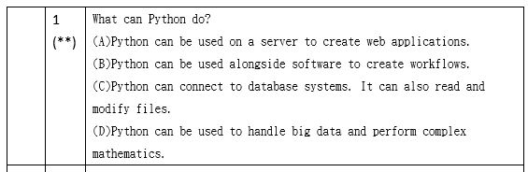
PYTHON
What can Python do?
Python can be used on a server to create web applications.
Python can be used alongside software to create workflows.
Python can connect to database systems. It can also read and modify files.
Python can be used to handle big data and perform complex mathematics.
Python can be used for rapid prototyping, or for production-ready software development.
http://www.w3schools.com\

Slide 5
DATA TYPES DICTIONARY
key
value
Dictionaries are used to store data values in key: value pairs.
A dictionary is a collection which is ordered*, changeable and do not allow duplicates.
As of Python version 3.7, dictionaries are ordered. In Python 3.6 and earlier, dictionaries are unordered.
Dictionaries are written with curly brackets, and have keys and values:
thisdict = {
"brand": "Ford",
"model": "Mustang",
"year": 1964
}
print(thisdict)
key:value pairs

Slide 6
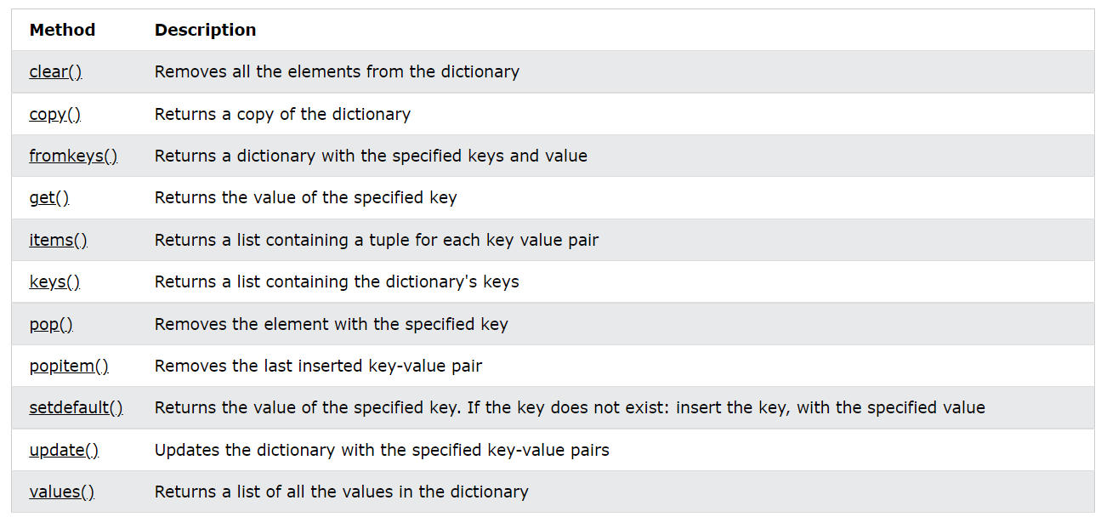
Dictionary Methods

Slide 7
